Slide 1


PMC-592 MCPM
Multi Circuit Power Monitor

Slide 2

TIA-942, PDU Definition
A typical PDU includes all of the following:
transformer disconnect.
transformer: This should be located as close to the load as possible to minimize common-mode noise between ground and neutral and to minimize differences between the voltage
source ground and signal ground. The closest possible location is achieved when the
transformer is located within the PDU enclosure. The isolation transformer is usually
configured as a 480:208V/120 volt step-down transformer (or based on the local standard) to reduce the feeder size from the UPS to the PDU. To withstand the heating effects of harmonic currents, K-rated transformers should be used...
Transient Voltage Surge Suppression (TVSS)
Distribution Panel Boards: Panel boards can be mounted in the same cabinet as the transformer or in cases where more panel boards are needed, a remote power panel can be used;
Metering, monitoring, alarming, and provisions for remote communications: such features
would typically imply substantially space requirements when provided with a traditional panel
board system;

Slide 3
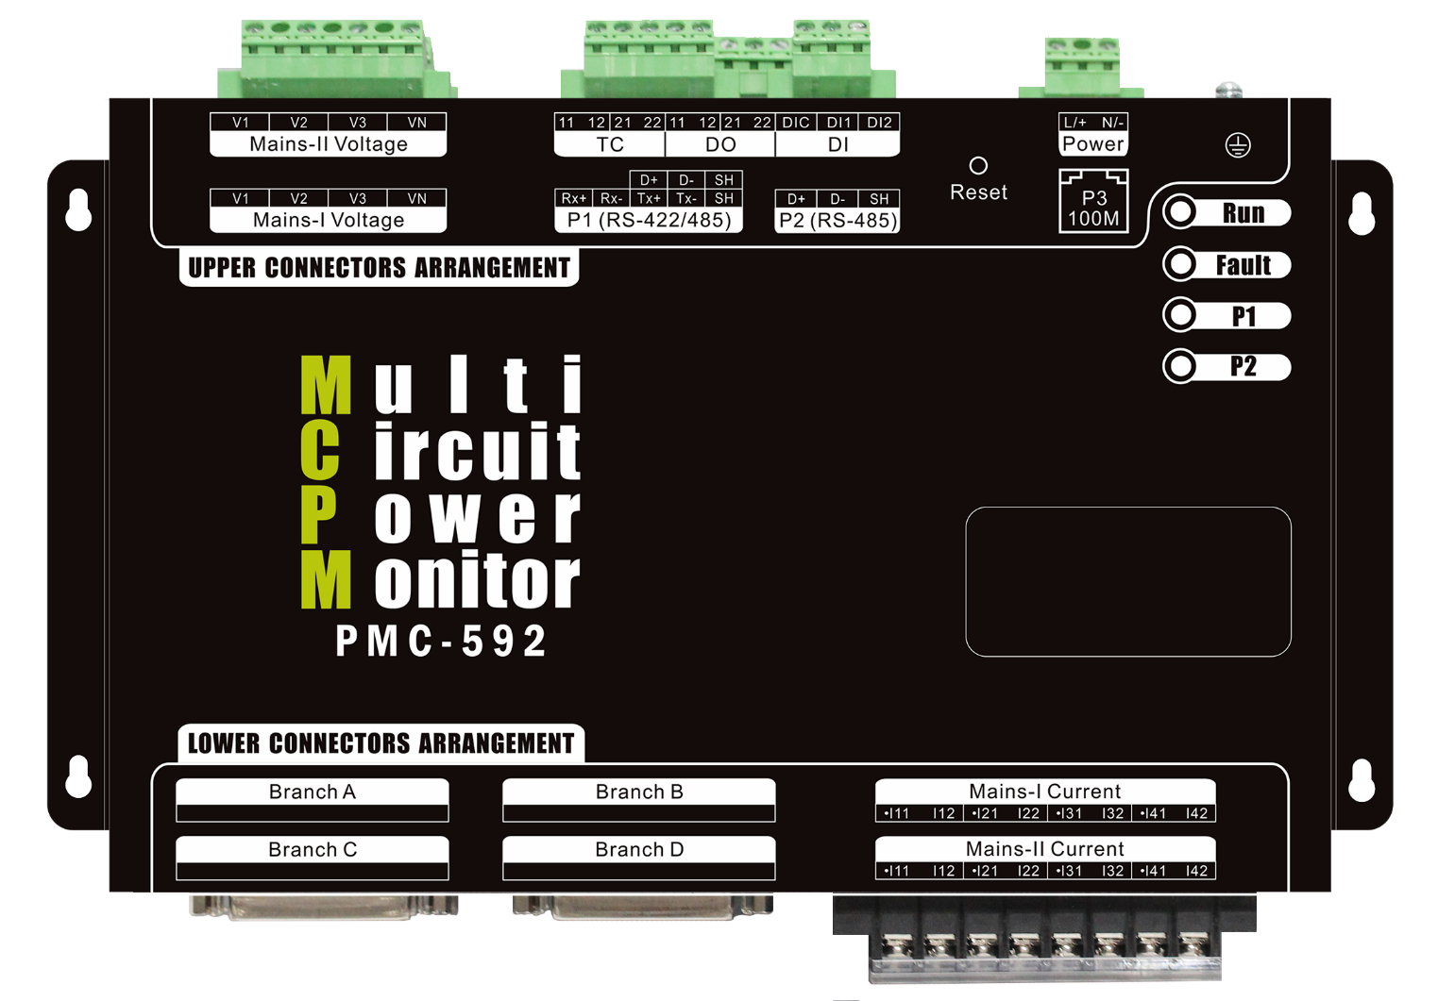
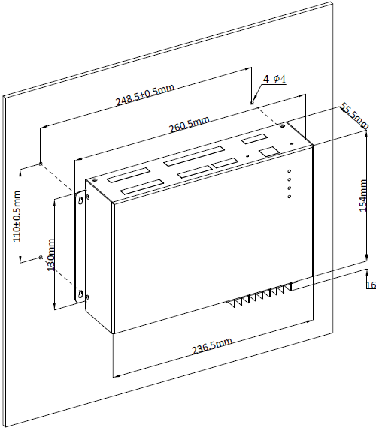
The Best Solution in the market for Data Centers to pursue higher uptime.

Slide 4
PMC-592 MCPM Features
Accepts 2 Mains, each with 3-Ø Voltage & 4-Ø Current Inputs
Supports different PDU configurations
Mains Split Core CTs (400A – 1000A)
1 to 4 Branch Circuits of 21 CTs each
100A Branch CTs amperage rating
Any number of split core CTs, up to 84 maximum, can be installed with a single PCM-592 => Ideal for retrofit applications
Friendly user-configurable Virtual Meters (10 max.) for any combination of physical branch circuits
Allows the mixture of 1-, 2-, & 3-phase loads

Slide 5
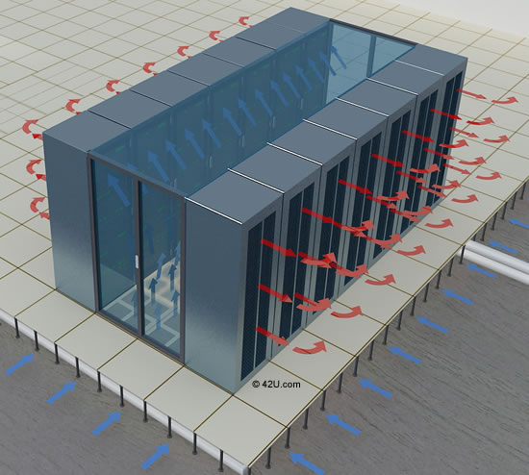
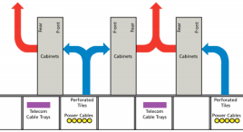
PMC-592 MCPM Features(Cont.)
2xRTD Inputs (Pt100 sensors) to provide temperature measurements and alarming for Hot Aisle & Cool Aisle at the same time.
2xDI to provide the breaker On/Off status of 2 Mains.
2xDO with Setpoint can be collaborated with PDU’s EPO/REPO to provide emergency tripping.
Two serial ports: RS422/RS485 (P1), RS485 (P2), supporting Modbus RTU protocol.
One 100Mbps (P3) Ethernet port supports: Modbus TCP, HTTP, SMTP, FTP, SNMP, SNTP
Remote 7” color touch screen HMI Display
EPO=Emergency Power Off
REPO=Remote Emergency Power Off
TIA-942

Slide 6

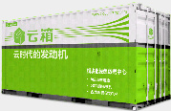
PMC-592 MCPM Features(Cont.)
Log Memory to record electrical and temperature measurements
Comprehensive Event Log to provide event evidence tracking.
Sophisticated alarm mechanism with 4-step settings (HH, H, L, LL) provide early warning of a heavily loaded branch MCB and thus prevent the thermal tripping and improve power reliability and distribution efficiency. The accurate measuring capability allows it to identify unwanted sudden tripping of any branch MCB to provide the earliest warning. The design of Global Alarm provides easier management for the data center operators.
Metal Enclosure to provide better EMC shielding
Industrial Grade electronic components, Extended Temp and Standard Tropicalization.

Slide 7


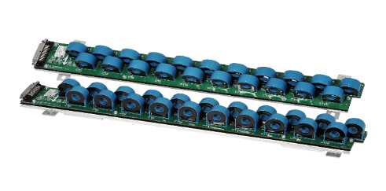
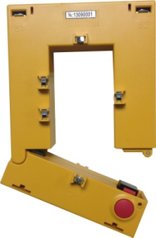
PMC-592 Components
92 = 4I (Mains-I) + 4I (Mains-II) + 21I x 4 Branches = 92
7” Color touch-screen HMI
Main Unit
Mains Split-core CT
x4 or x8
From 400A to 1000A
Up to 4 Branch Circuits of 21 CTs each
x1, x2, x3 or x4

Slide 8
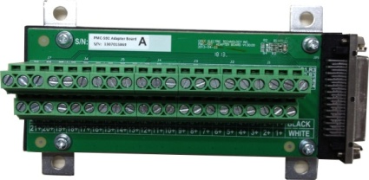
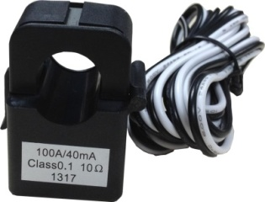

PMC-592 Components(Cont.)
Branch Split Core CT (100A)
Adapter Board for Split Core Branch CTs for easy wiring
High-Quality and Reliable Branch Circuit Cable

Slide 9

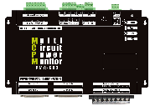


Typical Connections, 4 CT Strips
Single Mains
With
4 Branches
(84 circuits)
4xSplit Core CTs
3-Ø
Voltage Inputs
R S T
42-Pole Panel board
Color touch-screen HMI
R S T
42-Pole Panel board

Slide 10
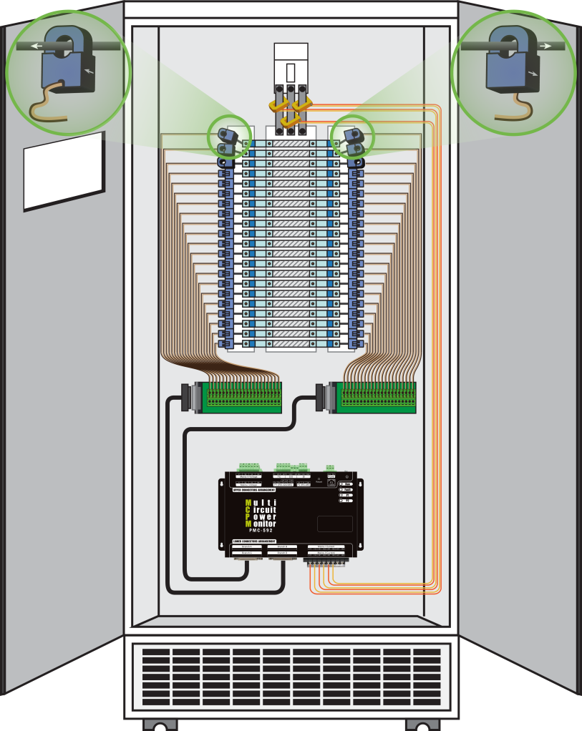
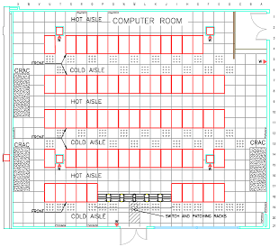
Typical Connections, SCCTs

Slide 11
Applications
1-Ø, 2-Ø, 3-Ø sub-meter billing for Data Centers' customers
Early Warning for feeder loading/availability status
Provide fast, accurate & real-time information for PUE server
Substation LV panel multi-circuit metering
Lighting panel metering
Power quality monitoring with waveform recording(*)
* Released but not launched

Slide 12
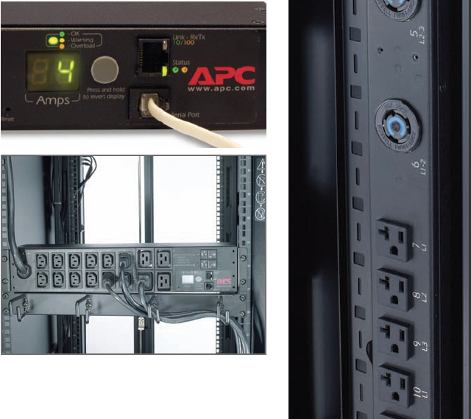
Measurements for PUE
Other DC Systems
Lighting
Manage-ment
Server Farm
HVAC
Fire-Control
RACK
#1
Meter
G
IT Equip.
#1
Power Entrance
#1
Meter
A
Trans-former
UPS
#1
Meter
C
PDU
#1
Meter
E
RACK
#2
Meter
H
IT Equip.
#2
Power Entrance
#1
Meter
B
Trans-former
UPS
#n
Meter
D
PDU
#n
Meter
F
RACK
#3
Meter
I
IT Equip.
#3
PMC PQ
Meters
PMC-592
Mains
PMC-592 Virtual
Meter
RACK
#n
Meter
J
IT Equip.
#n

Slide 13
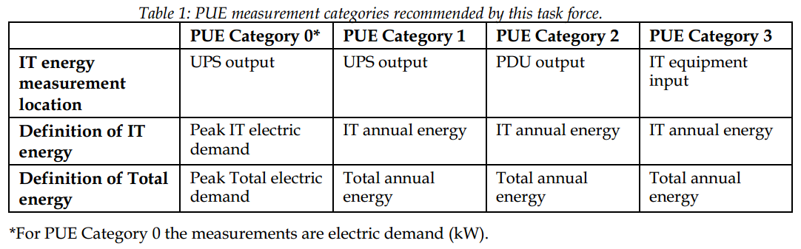

Measurements for PUE
(Meter A + Meter B)
(Meter A + Meter B)
(Meter A + Meter B)
(Meter A + Meter B)
PUE =
(Meter C + Meter D)
(Meter C + Meter D)
(Meter E + Meter F)
(Meter G+H+I+J)
(Outdated due to low accuracy)
Supported by
PMC-592
‘Mains’
Supported by
PMC-592
‘Virtual Meter’
Too expensive
(& No/poor alarm)

Slide 14
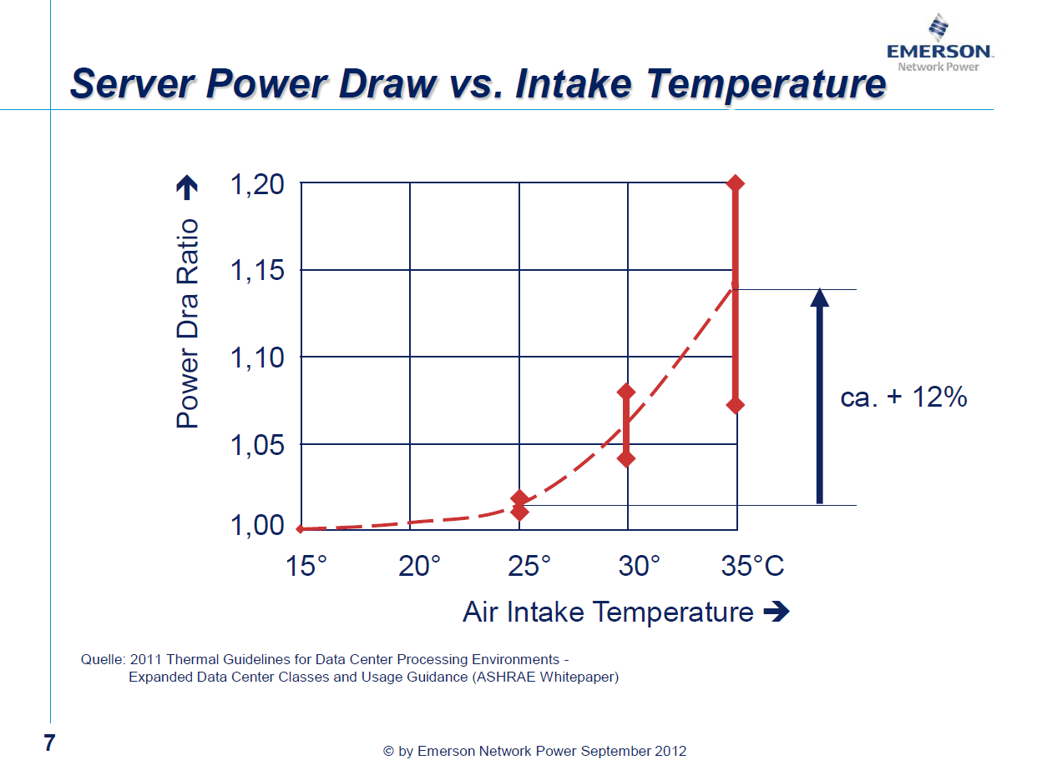
kW Consumption vs. Temperature

Slide 15
Measurements
Powerful Embedded Web Interface with Password Protection
Branch Circuits Measurements
    21, 42, 63 or 84 Branch Current Inputs
    I, kW, kvar, kVA, PF, Loading Factor, kWh, kvarh, kVAh per circuit
    I Average, kW Total, kvar Total, kVA Total, PF Total, kWh Total, kvarh Total, kVAh Total per 1Φ , 2Φ or 3Φ sub-metering configuration
Demand Measurements**
    Mains - I per phase, kW Total, kvar Total, kVA Total
    Branches - I, kW, kvar, kVA per circuit
    Sub-Metering Total for 1Φ , 2Φ or 3Φ configuration
    Max. Demands with timestamp for This Month, Last Month and since Last Reset

Slide 16
Measurements(Cont.)
Power Quality
    Mains
        V and I Unbalance based on Sequence Components
        K-Factor
        THD, TOHD, TEHD and Individual harmonics to 31st
        Waveform Recording at 64 samples/cycle (*)
        Sag/Swell detection
    Branches
        THD per Current Input
Waveform Recording (*)
    Mains - Waveform Recording at 64 samples/cycle (*)
    COMTRADE File Output(*)
SOE Log
    1000 events time-stamped to ±1ms resolution
    Setup changes, Setpoint events, Alarms, I/O operations, Control and Diagnostics

Slide 17
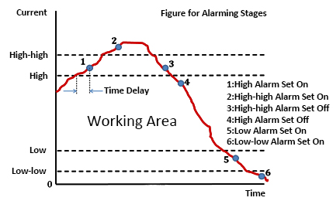
Measurements(Cont.)
Data Recording
    On-board log memory
    Interval Energy and Demand Consumption
    Recording interval: 5 min, 10 min, 15 min, 30 min, 60 min
    10,000 Energy logs to store 105 days @ 15min., 70 days @ 10min. or 35 days @ 5min
Alarming
    Sophisticated alarming settings for V, I, kW, PQ, Temp. to help manage the IDC
    Support High-High, High, Low, and Low-Low Alarms
    Configurable Threshold and Time Delay for each circuit
    Support Global Alarm Output
    All alarms are recorded in the SOE Log

Slide 18
Measurements(Cont.)
Ease of use
      Status LEDs - Run, Fault, and Comm. Activities
      Self-diagnostic function
      View / Setup via touch-screen HMI, or embedded web interface, password-protected
      Surface Mount for the Main Unit and Panel Mount for the HMI
Mains Inputs Measurements
      2 Mains supporting 3-phase voltages and 4-phase currents
      VLN and VLL per phase and average
      I per phase and average, I4 (measured), I0 (calculated)
      kW, kvar, kVA, PF per phase and total
      Frequency
      Loading Factor per phase and average
      kWh Total, kvarh Total, kVAh Total

Slide 19
Measurements(Cont.)
Digital Inputs
    2 DI channels, volts free dry contact, 24VDC internally wetted
    External status monitoring with programmable de-bounce
Digital Outputs
    1000Hz sampling 2 DO channels for control and alarming
    Collaborates with Setpoint status
RTD Temperature Inputs
    2 Channels for monitoring the front and rear of PDU Cabinet, or the transformer inside
    Pt100 sensor (not included)
Real-time Clock
    6ppm battery-backed real-time clock (<0.5s per day)
    SNTP time synchronization supported

Slide 20
Measurements(Cont.)
Port 1 RS422/RS485, Port 2 – RS485
    Optically isolated
    Modbus RTU protocol
    1,200 to 38,400 Baud
Port 3 – 10/100M Ethernet
    Modbus TCP, HTTP, SMTP, SFTP, SNMP, SNTP
Virtual Metering
    Up to 10 Virtual Meters
    Configurable for 1-Ø, 2-Ø or 3-Ø aggregation from any branch circuits (CB1 – 84) **from 1-Phase Sub-Meters

Slide 21

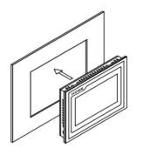
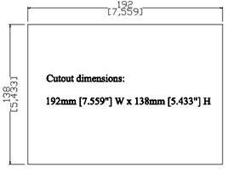
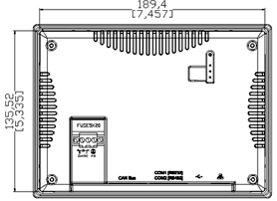
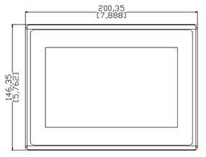
PMC-592 HMI
7” touch screen LCD display with LED back light
35536 color, 16:9, 800x480
128MB Flash, 64MB DDR2 RAM
24VDC±20%(Power Supply included in package)
IP 65 protection level
Operating Temp: 0 to +70℃
Dimensions: 200x146x41.8mm (Cutout: 192x138mm)
RS422 connection to PMC-592’s Port 1
Standard 3M cable provided
Maximum distance = 1500M, can be installed in the central control room

Slide 22
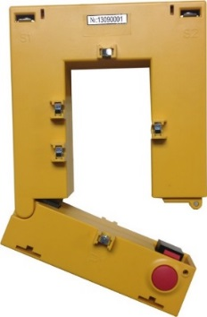
Mains Split Core CT
CT Primary Ratings (In)：
      400A
      600A
      800A
      1000A
CT Secondary Rating：
    1A
Consumption：< 0.1VA /phase @ In
Accuracy range：0.01～1.0In
Starting point：0.4%In
Overload：0 to 1.2In Continuous

Slide 23
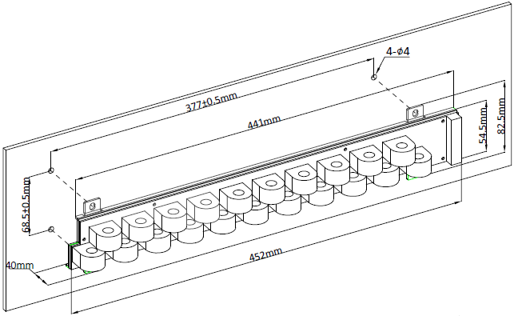
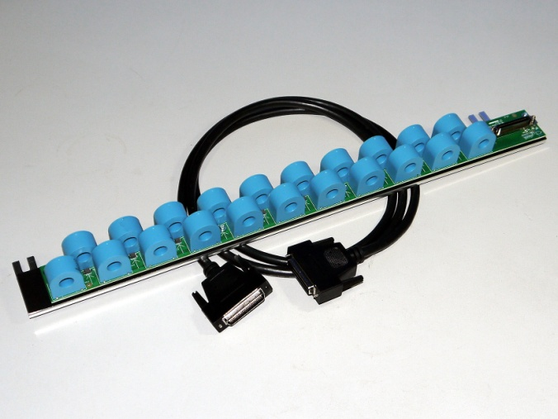
Branch CT Strip
2 CT spacing distances (center-to-center), ¾” & 1”, to adapt to various MCBs.
In = 50A (max. 100A continuous)
Range：0.01xIn - 2xIn
Starting Current: 20mA
500A overload for 1s
Branch CT accuracy: 0.1%
Open-circuit protection
Bi-directional measurements
Installed beside PDU’s branch MCB to simplify wiring
Flexible configuration: programmable CT polarity, CT sequence, voltage reference per branch circuit
CT Strip orientation (Cross-over or Sequential)
The pole count, orientation and the polarity of the CT strip are all configurable to adapt to different panel layouts

Slide 24
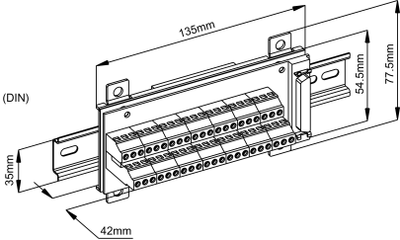

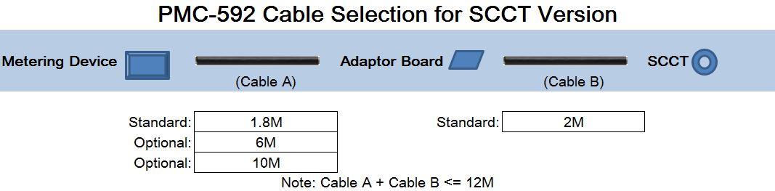
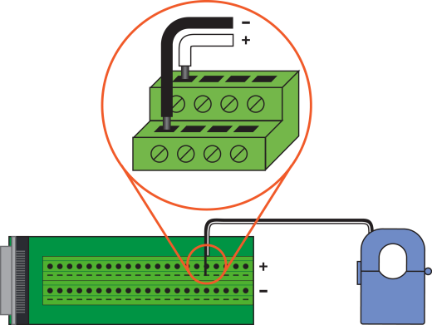
Branch SCCT
Can supply the exact number of SCCT needed
SCCT is compatible for any branch feeder
Standard cable length for adapter board: 1.8m, optional 6m and 10m
Standard SCCT output wire length: 2m
Total cable length should not exceed 12m to ensure accuracy

Slide 25
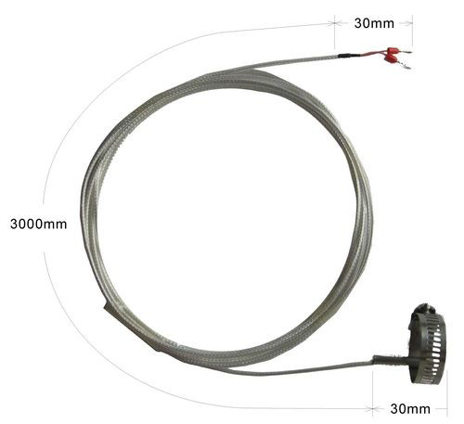

RTD Input(PT100)
TC1, TC2
Temp. Range: -40 to 200 ⁰C
Accuracy: ±1.0 ⁰C
Resolution: 0.1 ⁰C
PDU’s Cabinet, Transformer, IDC hot ambient.
TIA-942:
The temperature and humidity shall be controlled to provide continuous operating ranges for temperature and humidity:
- dry Bulb Temperature: 20 ⁰C to 25 ⁰C;
- relative Humidity: 40% to 55%;
- maximum Dew Point: 21 ⁰C ;
- maximum Rate of Change: 5 ⁰C per hour;

Slide 26
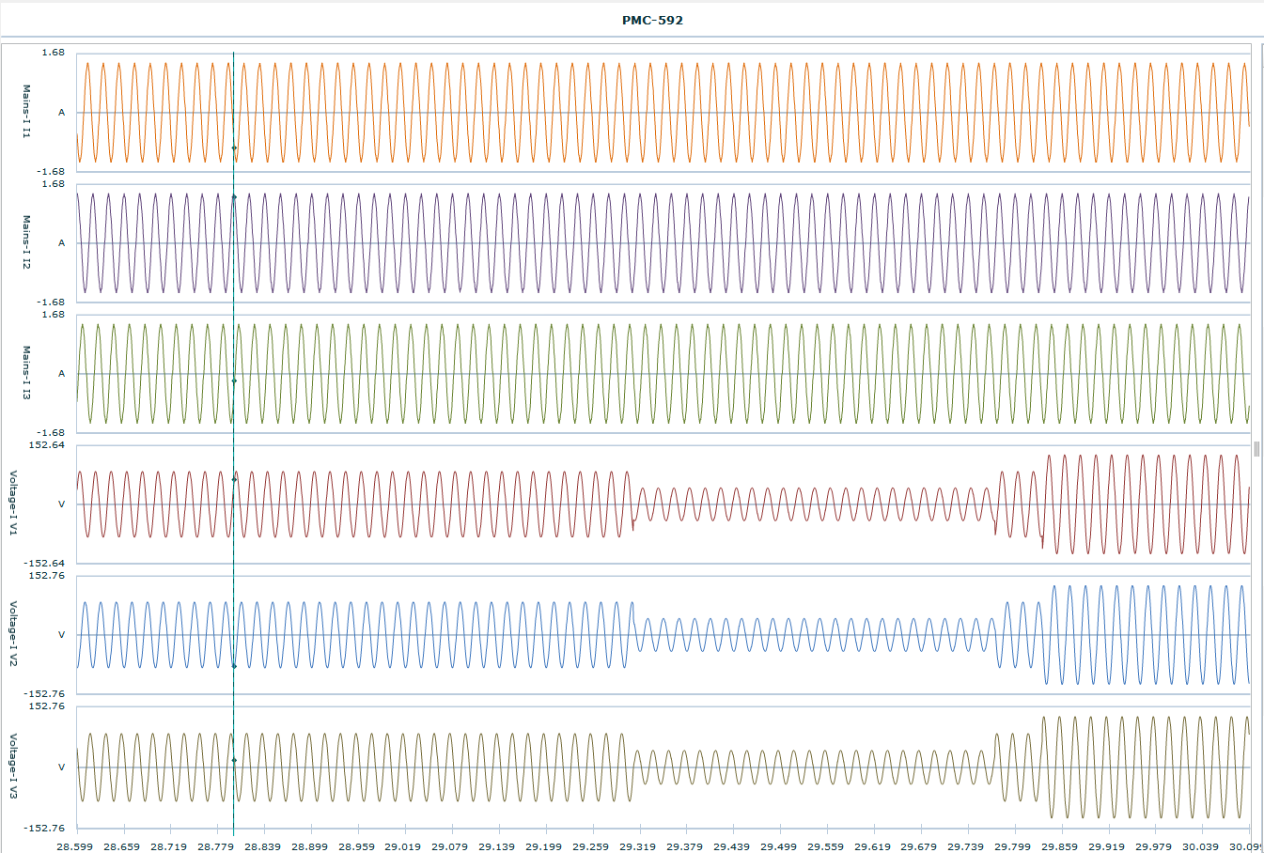
Waveform Recording(*)
Triggered by alarm (Mains-I, Mains-II), DI/DO or manual operation
Up to 16 records in COMTRADE file format
Each log contains all V and I channels of Mains-I and Mains-II
Configurable sampling rates: 64x150, 32x300, 16x600 (samples x cycles)
(*Not officially launched)

Slide 27
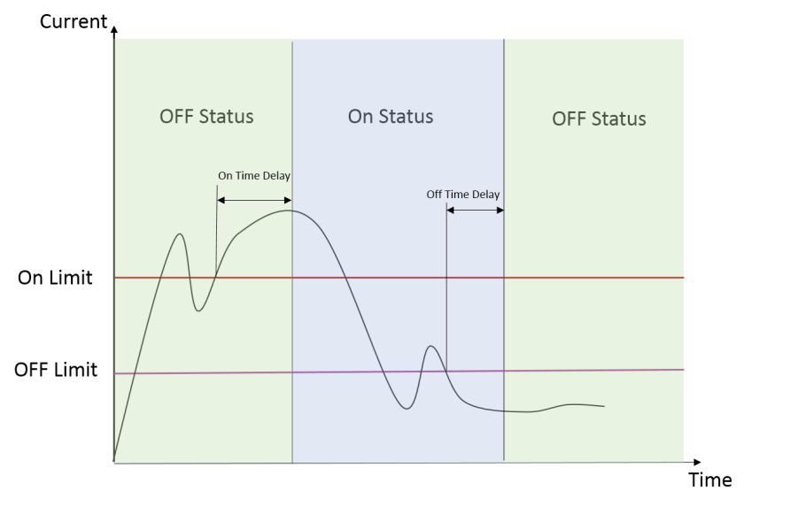


Intelligent Branch Utilization Status
For each current channel, an ON/OFF status is provided to indicate the “Branch Utilization” status.
This will avoid the false LOW or LOW-LOW alarm.
Logic diagram of ON status
Logic diagram of OFF status

Slide 28
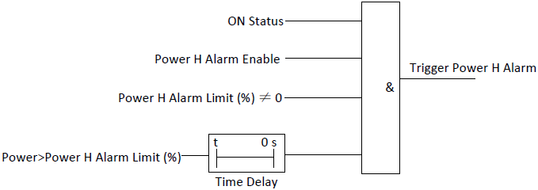
Alarm & Setpoint
Logic diagram of power H alarm
Sophisticated Alarming functions
Latched Alarms
      H-H, High, Low, L-L and L-Off
      Status with Time Delay and Counter
Momentary Alarms
    High and Low with hysteresis settings
    Status only

Slide 29
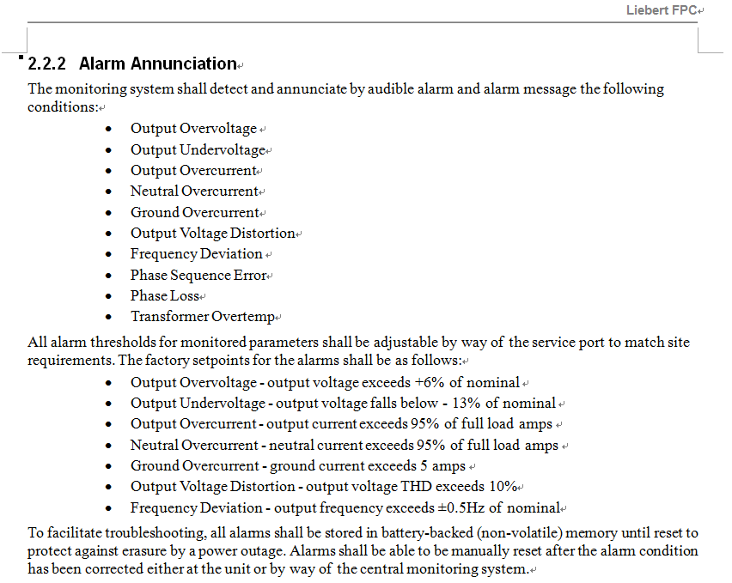
Pioneer’s Alarming Requirements
Specifications from Emerson FPC
PMC-592 does not comply:
Phase Sequence Error
Such mistake can only occurred once, and can and should be easily corrected by the electrical contractor.
Ground Overcurrent
  It requires the 5th CT.
  In sophisticated data center, such fault should not occur.
  It can be included into the fire control category.
Phase Loss
It has been covered by our alarm mechanism (voltage L, LL, or I unbl)

Slide 30
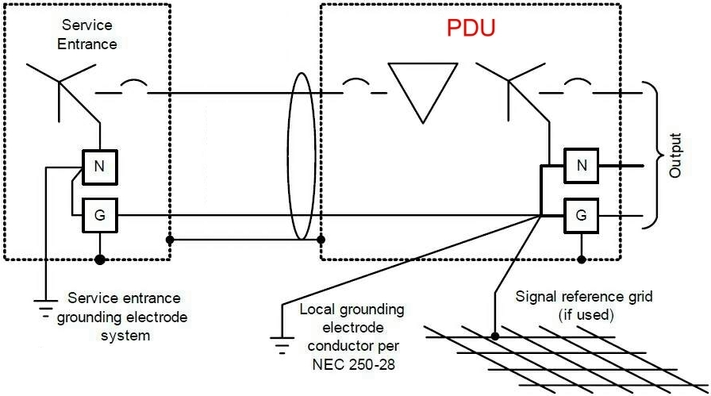
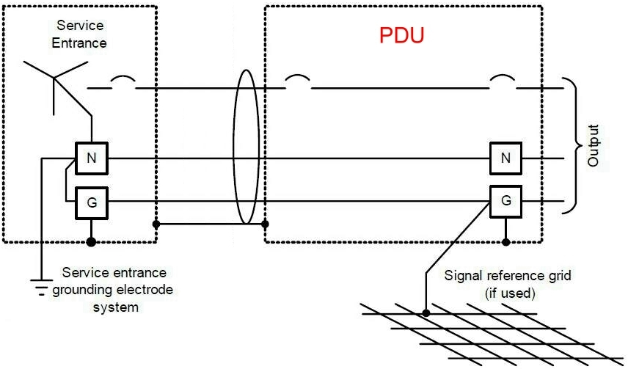
PDU – Electrical Viewpoint
with Isolation Transformer
without Isolation Transformer

Slide 31
5 Panel Modes
The PMC-592 supports 5 panel modes, i.e. 5 different electrical configuration of PDU, to best fulfill all data centers’ specific requirements :
Single Panel Mode I
Early Single Panel Mode II
Dual Panel Mode I
Dual Panel Mode II
1-phase 3-wire

Slide 32
TIA-942, Redundancy Categories
G.2 Redundancy
G.2.1 N - Base requirement
System meets base requirements and has no redundancy.
G.2.2 N+1 redundancy
N+1 redundancy provides one additional unit, module, path, or system in addition to the minimum
required to satisfy the base requirement. The failure or maintenance of any single unit, module, or
path will not disrupt operations.
G.2.3 N+2 redundancy
N+2 redundancy provides two additional units, modules, paths, or systems in addition to the
minimum required to satisfy the base requirement. The failure or maintenance of any two single
units, modules, or paths will not disrupt operations.
G.2.4 2N redundancy
2N redundancy provides two complete units, modules, paths, or systems for every one required
for a base system. ”Failure or maintenance of one entire unit, module, path, or system will not
disrupt operations.
G.2.5 2(N+1) redundancy
2 (N+1) redundancy provides two complete (N+1) units, modules, paths, or systems. Even in the
event of failure or maintenance of one unit, module, path, or system, some redundancy will be
provided and operations will not be disrupted.

Slide 33
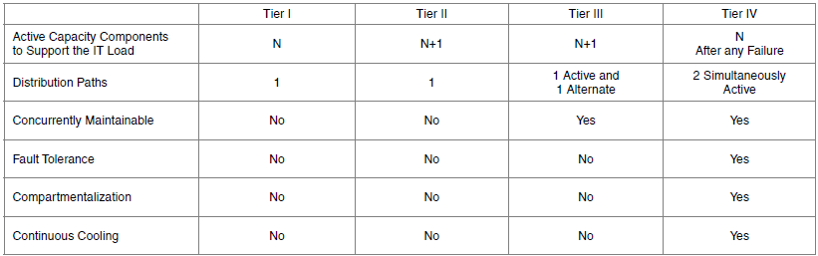

Uptime Institute Tier Req.

Slide 34
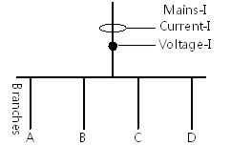
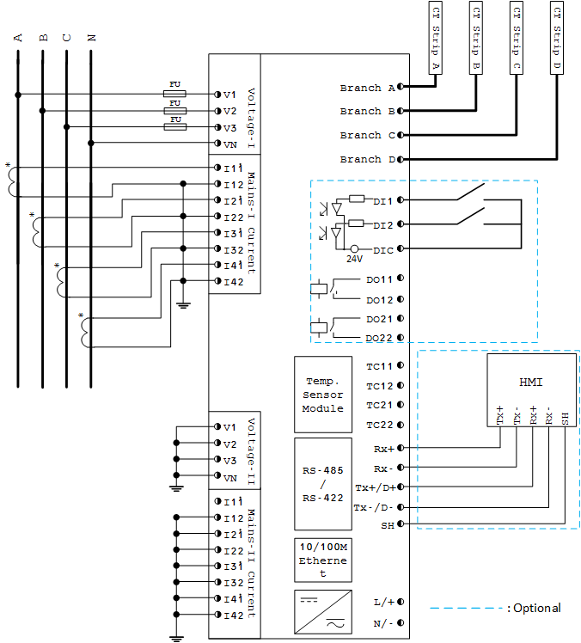
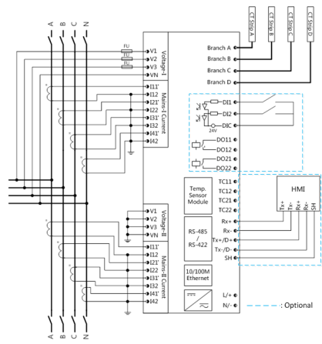
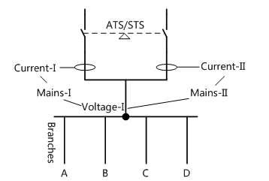
Single Panel Mode I
Power Calculation:
Mains-I Power = V1 × I1
Branch Power = V1 × Branch Current
1 Mains
2 Mains
Power Calculation:
Mains-I Power = V1 × I1
Mains-II Power = V1 × I2
Branch Power = V1 × Branch current

Slide 35
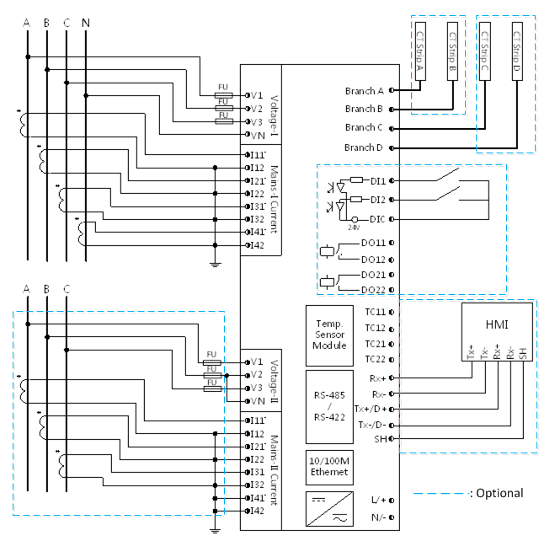
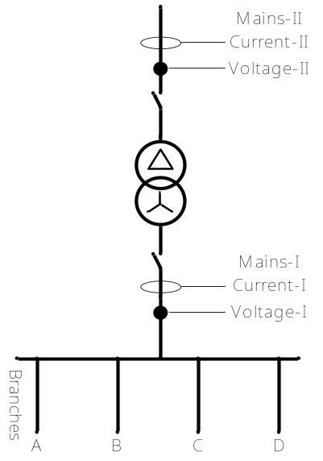
Single Panel Mode II
Primary & Secondary of the Isolation Transformer
Power Calculation:
Mains-I Power = V1 × I1
Mains-II Power = V2 × I2
Branch Power = V1 × Branch Current

Slide 36
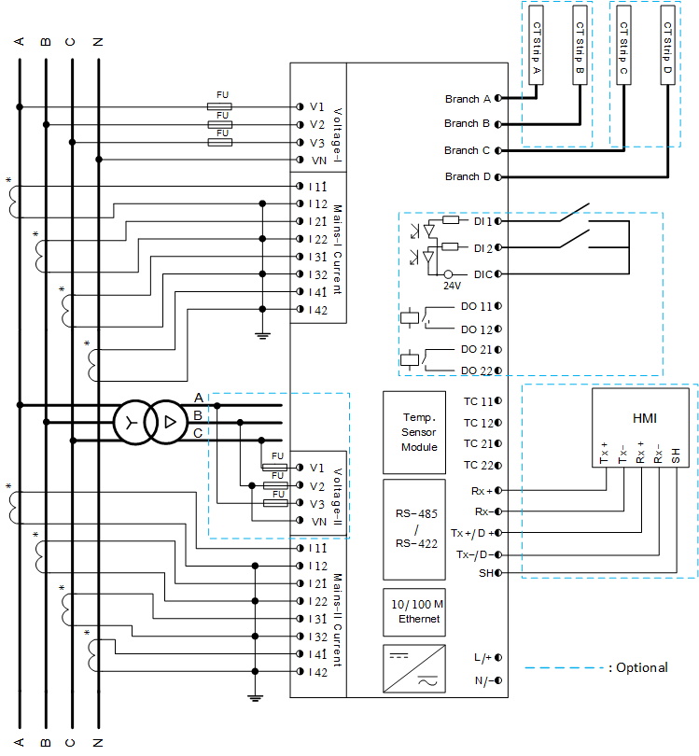
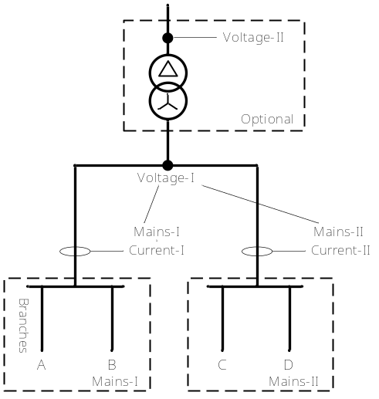
Dual Panel Mode I
2 Mains Breakers in 1 PDU
Power Calculation:
Mains-I Power = V1 × I1
Mains-II Power = V1 × I2
Branch Power = V1 × Branch Current

Slide 37
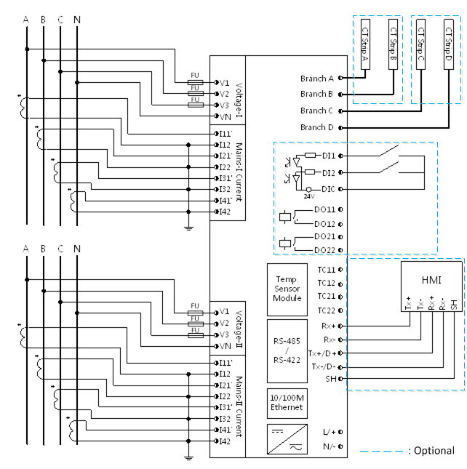
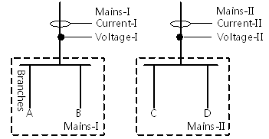
Dual Panel Mode II
2 independent PDUs
(Most competitive)
Power Calculation:
Mains-I Power = V1 × I1
Mains-II Power = V2 × I2
Branch A, B Power = V1 × Branch I
Branch C, D Power = V2 X Branch I

Slide 38
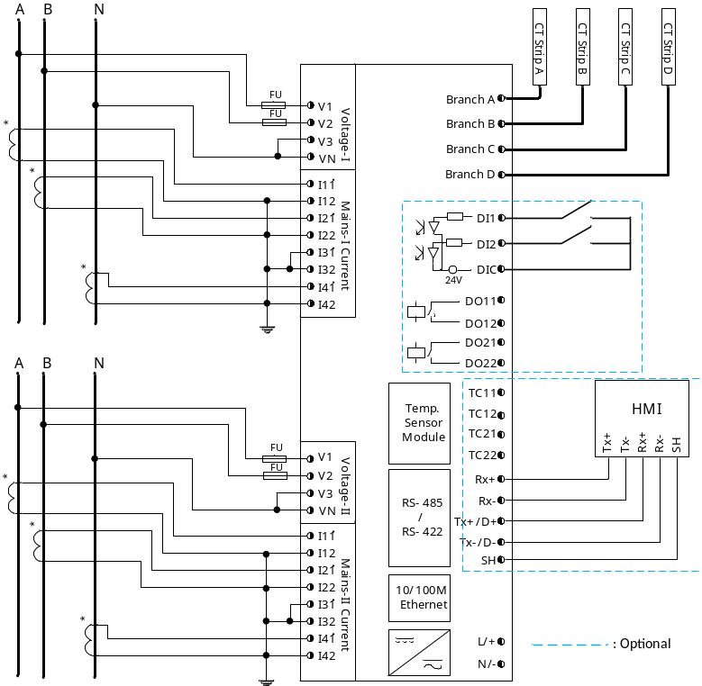
1-phase 3-wire
For 1P3W applications
e.g. lighting panel,
commercial panelboard,
residential load center,
dormitory billing.

Slide 39
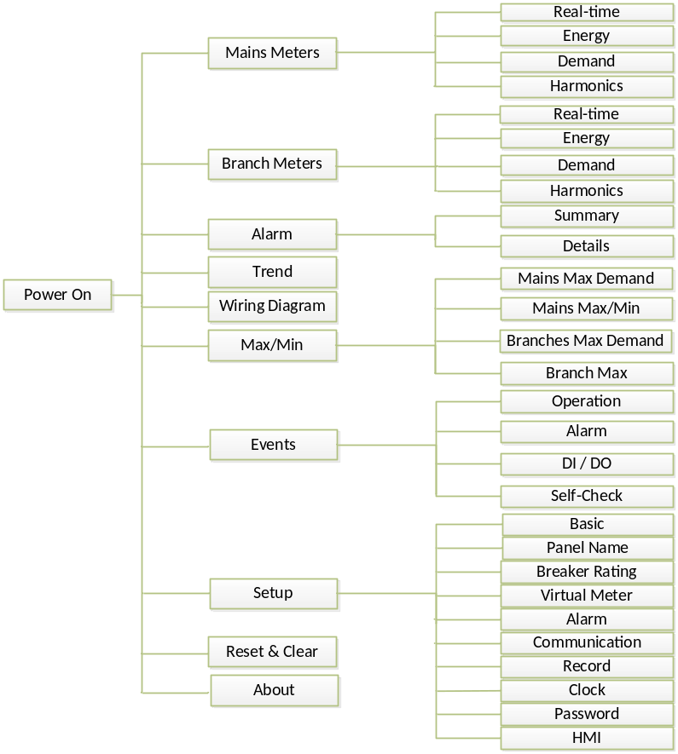
HMI Menu

Slide 40
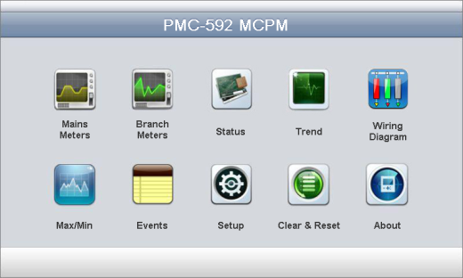
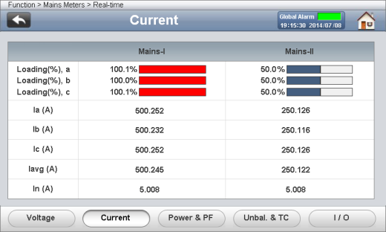
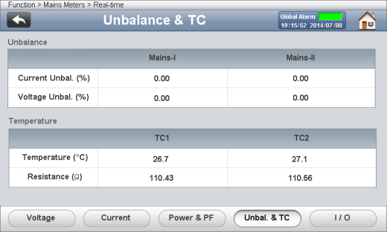
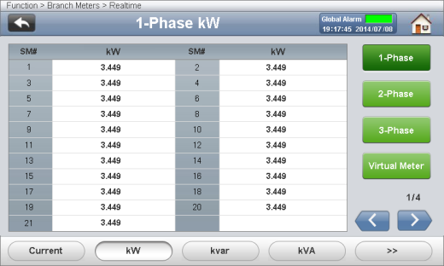








HMI Display Examples

Slide 41











HMI Display Examples(Cont.)
And more…

Slide 42

Comprehensive Web Interface

Slide 43





Demo Kits Available on Request

Slide 44















Competitive Analysis

Slide 45
Accuracy
Parameters |  | Accuracy | Resolution
Mains | Voltage | ±0.5% | 0.01V
 | Current | ±0.5% | 0.001A
 | kW, kvar, kVA | 0.5% | 0.001k
 | kWh, kVAh | IEC 62053-22 Class 1 | 0.1kXh
 | kvarh | IEC 62053-23 Class 2 | 0.1kvarh
 | P.F. | ±1.0% | 0.001
 | Frequency | ±0.02 Hz | 0.01Hz
 | Harmonics | IEC 61000-4-7 / 30 Class B | 0.01%
 | V Unbalance | ±0.2% | 0.01%
 | I Unbalance | ±1.0% | 0.01%
Branch | Current | ±0.5% | 0.001A
 | kW, kvar, kVA | 1% | 0.001k
 | P.F. | ±1.0% | 0.001
 | kWh | IEC 62053-22 Class 1 | 0.01kXh
 | kvarh | IEC 62053-23 Class 2 | 0.1kvarh
 | Harmonics | IEC 61000-4-7 / 30 Class B | 0.01%
RTD |  | ±1° | 0.1°

Slide 46
Specifications
Mains Voltage Inputs (V1, V2, V3, VN)
Standard (Un) | 277VLN/480VLL
Range | 10% to 120% Un
PT Ratio | Not Supported
Overload | 2xUn continuous, 4xUn for 1s
Burden | <0.05VA per phase @ 220V
Frequency | 50Hz / 60Hz
Branch Current Inputs
Continuous Load (Imax) | 100A maximum
Burden | <0.3VA per phase @ In
Power Supply
Main | 95-277VAC/VDC ± 10%, 47-440 Hz
HMI | 24VDC ± 20%
Burden: Main | <5W
Burden: HMI | <10W
Mains Current Inputs
Nominal Current (In)
Solid-Core CT | 5A / 1A
Split-Core CT | 400A / 600A / 800A / 1000A
Range | 0.3% to 100% In
CT Ratio
Primary | 1A: 1-30000, 5A: 1-6000
Secondary | 1A: 1-30000, 5A: 1-6000
I4 Primary | 1-10000
I4 Secondary | 1-10000
Overload | 1.2xIn continuous, 2xln for 10s, 10xIn for 1s
Burden | <0.3VA per phase @ In
Digital Inputs
Standard | Dry contact, 24VDC internally wetted
Sampling | 1000Hz
Hysteresis | 1-1,000ms programmable
Digital Outputs
Contact Type | Normally-open
Contact Rating | 5A @ 250VAC/30VDC
RTD Input
Type | PT100
Range | -40 to 200 °C

Slide 47


CT Strip Dimensions (1” spacing)
Top View
Side View

Slide 48


CT Strip Dimensions (¾” spacing)
Top View
Side View

Slide 49

SCCT Adapter Board Dimensions

Slide 50

Branch SCCT Dimensions

Slide 51

THANK YOU!

